Slide 1
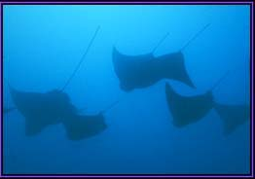
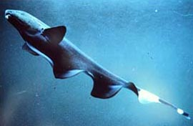
Electroreception in Fishes
By Megan Goldfarb

Slide 2

Introduction
All animals generate electrical signals
These signals are the result of active muscles
The ability for animals to sense these electrical signals is restricted to those in an aquatic habitat
  Air is an insulator, and thus not conducive to the conduction of electrical signals
  Electro-reception is more common in saltwater than in freshwater due to the higher conductance of saltwater

Slide 3
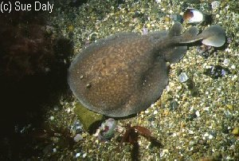
The Electro-reception Advantage
Electro-reception is a great tool for the 250 species of fishes who are equipped with it
  Its uses include:prey detection, navigation, communication, orientation, sex and species identification
    Many electro-receptive fish are nocturnal, and this ability makes life possible in the deep canals and rivers where they are found

Slide 4


The Shape of Things
There is a body shape which is particular to electro-receptive fishes
  Electroreceptive fish swim by undulating their elongated anal fin
    This anal fin runs along the nearly entire ventral side of the body
    They retain a rigid posture which contributes to what has been dubbed a “knife-like” appearance
  Non-electroreceptive fish swim by alternating the constrictions of their axial muscles

Slide 5

Electroreceptors
  The external surface of electroreceptive fishes have many electroreceptor organs
  The electrosensitive cells which make up these electroreceptor organs are found along the lateral line
  These organs are classified into two groups
    Ampullary Organs
    Tuberous Organs

Slide 6
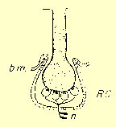
Ampullary Organs
Characterized by epidermal ampullae which contain sensory epithelium
  Receptor cells are found at the base of the ampullae
    These cells release neurotransmitters to sensory organs
    The epidermal ampullae are connected to the exterior of the fish by a long canal
    Ampullae of Lorenzini in Chondocrichthens, lungfish, stuergons
    Pit-organs in some teleosts (catfish, knifefish, elephantfish)

Slide 7

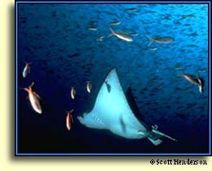
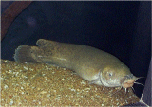
Ampullary Organs
Ampullary organs detect low frequency AC or DC fields
These fish respond slowly, giving long-lasting responses to low frequency stimuli
Species with ampullary organs include sharks,rays, certain teleosts

Slide 8
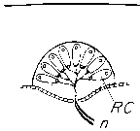
Tuberous Organs
Tuberous organs are composed of epidermal capsules which contain sensory epithelium, much like ampullary organs
But tuberous organs are NOT connected to the exterior by a canal

Slide 9
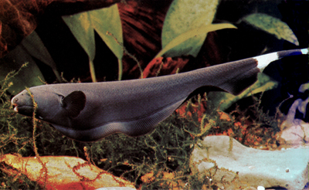
Tuberous Organs
Fish with tuberous organs respond rapidly by giving brief responses to high frequency stimuli
Tuberous organs are found only in weakly electric fish
Fish with these type of organs detect high-frequency, low-voltage AC fields
  They produce electric discharge in the milivolt range
A weakly electric black ghost knifefish (Apteronotus albifrons)

Slide 10
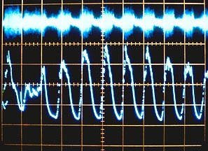
How it works
Using their electro-receptors, electric fish emit rhythmic patterns of electricity known as electric organ discharge (EOD)
Each species has its own distinct form of EOD
Fish detect distortions in their electric organ discharge fields caused by objects in the path of the discharge
  These objects cause changes in shape, amplitude and frequency of their electric field

Slide 11

Technical Difficulties
Electro-receptive fish work in conjunction with the earth’s electric field
  Sometimes signals from one fish interfere with those of another electric fish
  Each species has its own distinct form of EOD
  Environmental noise as caused by geological activity, lightening, oceanic currents also work to jam signals
  Many species have developed a jamming-avoidance response to this problem

Slide 12
Resources
http://alumnus.caltech.edu/~rasnaw/other.html
www.flmnh.ufl.edu/fish/tropics/JSA/gymno.htm
http://www.fw.msu.edu/courses/fu471/electro.ppt/
http://soma.npa.uiuc.edu/labs/nelson/nelson.html
www.unb.ca/courses/biol4775/SPAGES/SPAGES10.HTM
Liem, Karel F. Functional Anatomy of the Vertebrates. New York: Harcourt College Publishers,2001.

